Slide 1
Azure DevOps Tools
David Benedic

Slide 2
Agenda
What is DevOps?
Azure Resource Manager
Monitoring

Slide 3
What is DevOps?

Slide 4
3 “Ways” of DevOps*
Fast flow from development to production
Fast feedback from production back to development
A culture of continual experimentation and repetition
*Behr, Kevin, et al, “The Phoenix Project” http://itrevolution.com/books/phoenix-project-devops-book/

Slide 5
Before Cloud
Dev
QA

Slide 6
DevOps
Dev
QA
Ops

Slide 7
Azure Resource Manager

Slide 8
Demo: Exploring the ARM API
Notes:
Demo: VM Extension
Prerequisites:
Azure PowerShell v0.8 or higher has been installed and configured.
Desired Azure subscription has already been selected.
A storage account has been provisioned under the same Azure subscription.
A scripts container has been created under the storage account with public read access.
A helloworld.ps1 PowerShell script has been uploaded to the container. The content of the script is a single line: write-output “Hello World!”
PowerShell environment has been set with large font for easy reading.
A Windows Server 2012 VM has been provisioned.
Steps:
In Azure PowerShell, issue command: Get-AzureVMAvailableExtension | Format-Table -Property ExtensionName, Publisher
The above cmdlet lists existing extensions. Next we’ll see how we can inject an extension to a running VM instance. In the last demo you’ve seen that you can achieve this using Azure Management Portal. Here we’ll do it using PowerShell. In this case, we’ll install Custom Script Extension to an existing Windows Server 2012 VM.
Issue the following cmdlets to get a reference to the virtual machine instance:
$serviceName = “[cloud service that hosts the VM]”
$vmName = “[name of the VM]”
$vm = Get-AzureVM –ServiceName $serviceName –Name $vmName
Next, issue command Get-AzureVMExtension –VM $vm. This lists VM extensions that are currently installed on the VM.
Use the following cmdlet to enable Custom Script Extension, and instruct it to download and execute the helloworld.ps1 (this takes about 20-30 seconds):
Set-AzureVMCustomScriptExtension -ContainerName scripts -StorageAccountName '[your storage account name]' -VM $vm -FileName ‘helloworld.ps1' -Run ‘helloworld.ps1' | Update-AzureVM -Verbose
6. Next, we’ll retrieve and display the script execution result:
$status = Get-AzureVM -ServiceName $serviceName -Name $vmName
$result = $status.ResourceExtensionStatusList.ExtensionSettingStatus.SubStatusList | Select Name, @{"Label"="Message";Expression = {$_.FormattedMessage.Message }}
$result |fl
(see screenshots in hidden slides for references)
(see this blog: http://azure.microsoft.com/blog/2014/07/15/automating-sql-server-vm-configuration-using-custom-script-extension/ for more details on Custom Script Extension)

Slide 9
Automation Tools

Slide 10
ARM Templates
ARM templates can:
Simplify deployment
Simplify roll-back
Provide cross-resource configuration and update support
Be used as a learning
Azure templates are:
Source code, checked-in (Infrastructure as Code)
Resources and dependencies (VMs, websites, DBs) and connections (configuration, LB sets)
Parameterized for variable deployments
Deployed to an Azure Resource Group
Idempotent

Slide 11
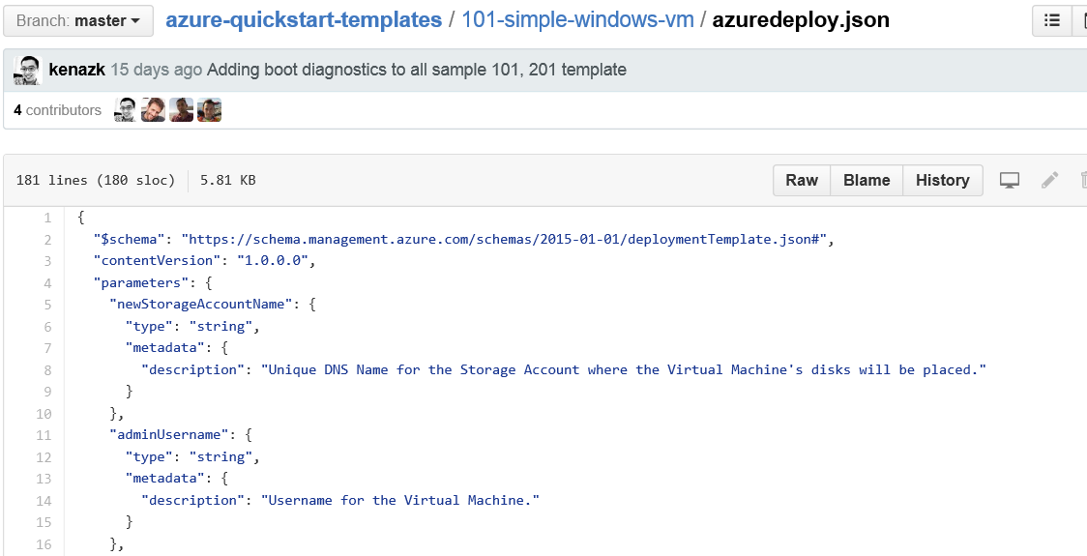
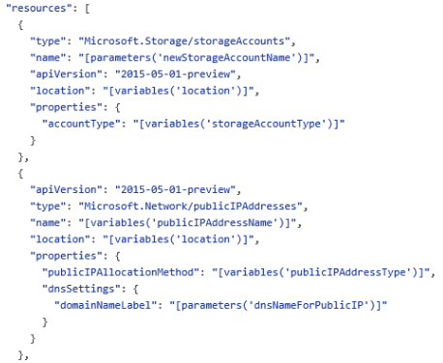
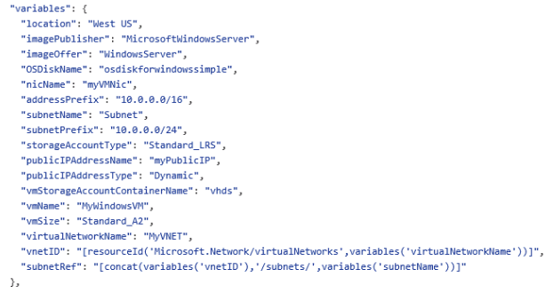
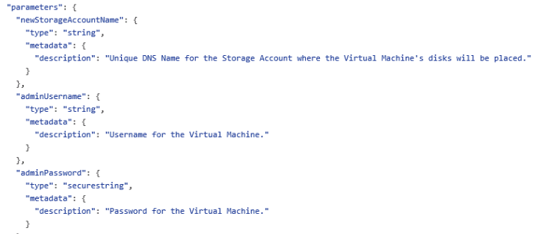
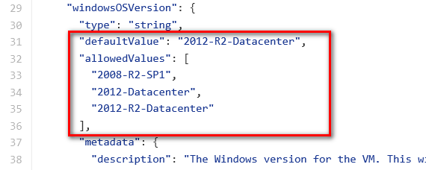
JSON files—simpler than they look Schema, content version, parameters, variables, resources, and outputs

Slide 12
Configuration Management
PowerShell DSC
First-class citizen in Windows
Chef, Puppet
Open source
Popular
Ansible
Agentless

Slide 13
Command Line Tools
AzureCLI
Cross platform
Version 1.x built on nodejs
Version 2 (preview) built on python
Includes tab completion!
AzureRM module for PowerShell
Familiar
Easy to install (using OneGet and WMF5)

Slide 14
Monitoring

Slide 15
Demo: Portal Monitor Center
Notes:
Demo: VM Extension
Prerequisites:
Azure PowerShell v0.8 or higher has been installed and configured.
Desired Azure subscription has already been selected.
A storage account has been provisioned under the same Azure subscription.
A scripts container has been created under the storage account with public read access.
A helloworld.ps1 PowerShell script has been uploaded to the container. The content of the script is a single line: write-output “Hello World!”
PowerShell environment has been set with large font for easy reading.
A Windows Server 2012 VM has been provisioned.
Steps:
In Azure PowerShell, issue command: Get-AzureVMAvailableExtension | Format-Table -Property ExtensionName, Publisher
The above cmdlet lists existing extensions. Next we’ll see how we can inject an extension to a running VM instance. In the last demo you’ve seen that you can achieve this using Azure Management Portal. Here we’ll do it using PowerShell. In this case, we’ll install Custom Script Extension to an existing Windows Server 2012 VM.
Issue the following cmdlets to get a reference to the virtual machine instance:
$serviceName = “[cloud service that hosts the VM]”
$vmName = “[name of the VM]”
$vm = Get-AzureVM –ServiceName $serviceName –Name $vmName
Next, issue command Get-AzureVMExtension –VM $vm. This lists VM extensions that are currently installed on the VM.
Use the following cmdlet to enable Custom Script Extension, and instruct it to download and execute the helloworld.ps1 (this takes about 20-30 seconds):
Set-AzureVMCustomScriptExtension -ContainerName scripts -StorageAccountName '[your storage account name]' -VM $vm -FileName ‘helloworld.ps1' -Run ‘helloworld.ps1' | Update-AzureVM -Verbose
6. Next, we’ll retrieve and display the script execution result:
$status = Get-AzureVM -ServiceName $serviceName -Name $vmName
$result = $status.ResourceExtensionStatusList.ExtensionSettingStatus.SubStatusList | Select Name, @{"Label"="Message";Expression = {$_.FormattedMessage.Message }}
$result |fl
(see screenshots in hidden slides for references)
(see this blog: http://azure.microsoft.com/blog/2014/07/15/automating-sql-server-vm-configuration-using-custom-script-extension/ for more details on Custom Script Extension)

Slide 16
Azure DevOps Tools

